Slide 1
computer network introduction,uses and components and data flow

Slide 2

Simply a Friend’s NETWORK

Slide 3
computer network
A computer network, often simply referred to as a network, is a collection of computers and devices interconnected by communications channels that facilitate communications among users and allows users to share resources.

Slide 4
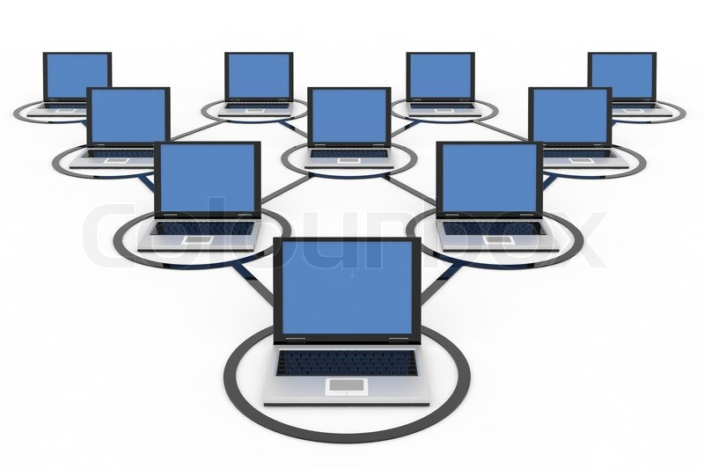
Collection of computers

Slide 5

devices

Slide 6
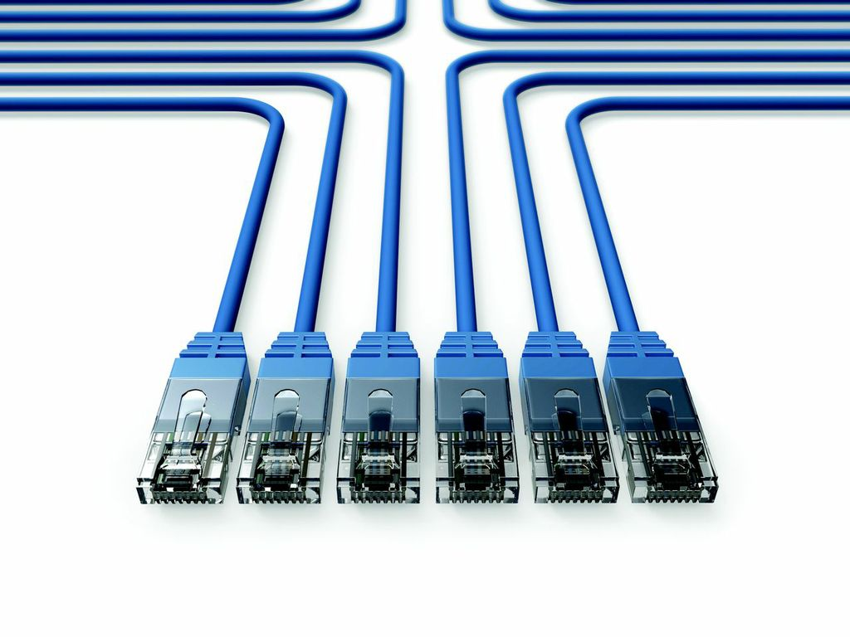

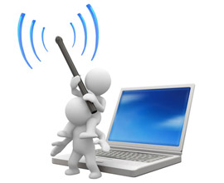
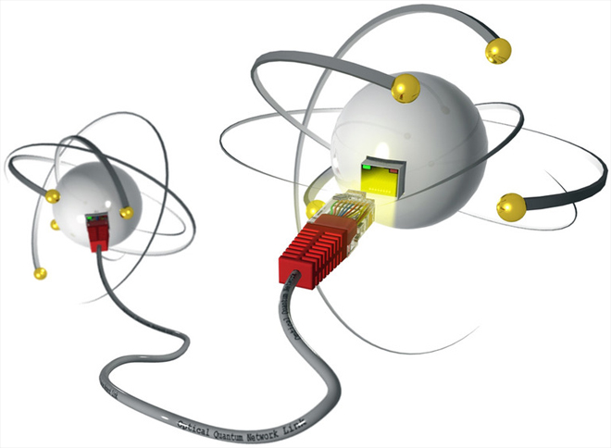

communications channels
WIRED
WIRELESS

Slide 7
Networks may be classified according to a wide variety of characteristics.
A computer network allows sharing of resources and information among interconnected devices.

Slide 8
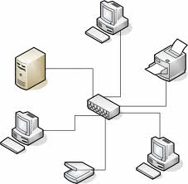

Slide 9
Computer networks can be used for a variety of purposes:
Facilitating communications: Using a network, people can communicate efficiently and easily via email, instant messaging, chat rooms, telephone, video telephone calls, and video conferencing.
Sharing hardware: In a networked environment, each computer on a network may access and use hardware resources on the network, such as printing a document on a shared network printer.
Sharing files, data, and information: In a network environment, authorized user may access data and information stored on other computers on the network. The capability of providing access to data and information on shared storage devices is an important feature of many networks.
Sharing software: Users connected to a network may run application programs on remote computers.
Speed up.

Slide 10


Components:
Message
Sender

Slide 11

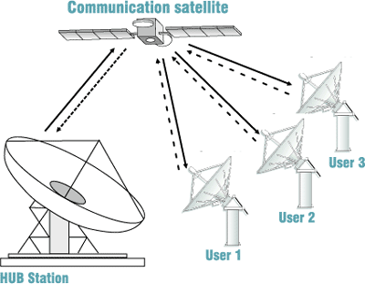
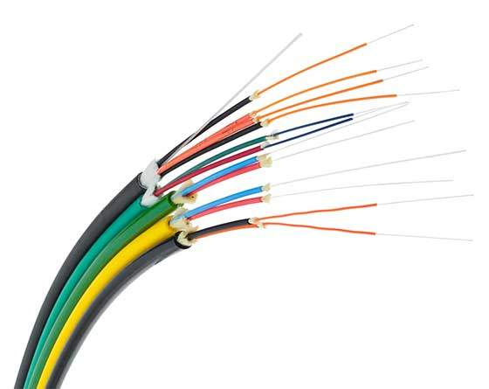
Receiver
Transmission medium

Slide 12
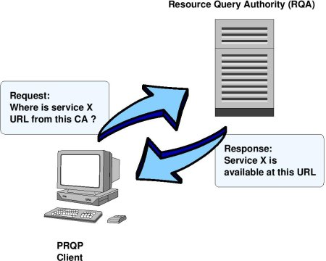
Protocol

Slide 13
ADDITIONAL READING IS STRONGLY RECOMMENDED

